Slide 1
Laptop Reviews
Your best decision is our will

Slide 2
Team member
Supervisor: Mr. Kiều Trọng Khánh
Võ Thị Minh Châu
Nguyễn Văn Hơn (Dropped out)
Đinh Hữu Toàn
Nguyễn Mạnh Khương

Slide 3
Outline
Scenario problem
Our solution
Demonstration
Advantages and disadvantages of current solution
Questions and answers
Future Plans

Slide 4




Scenario problem
Notes:
- ngta can biet thong tin de lam gi do, de tra cuu, de so sanh de tim hieu, mua...

Slide 5
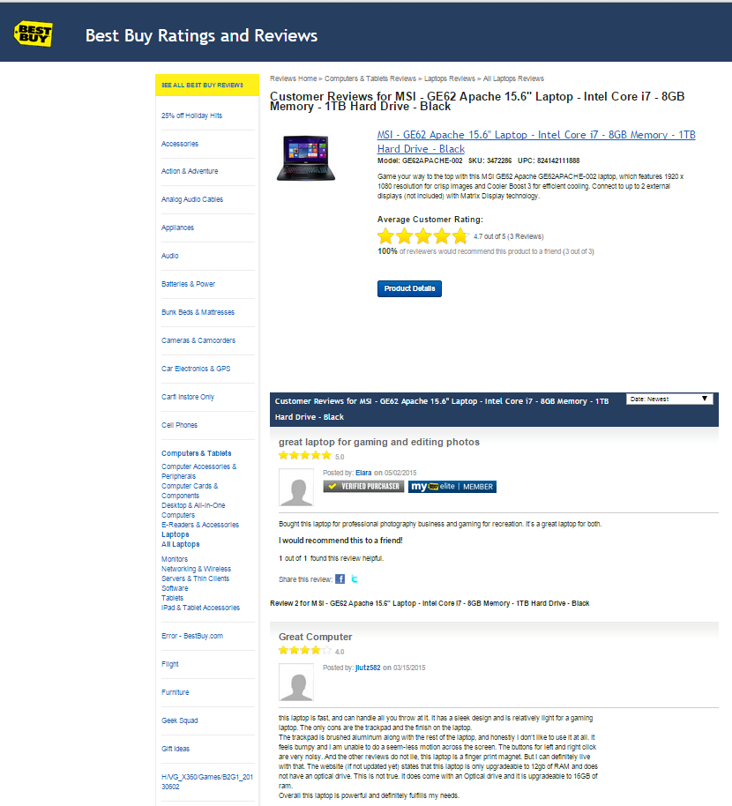
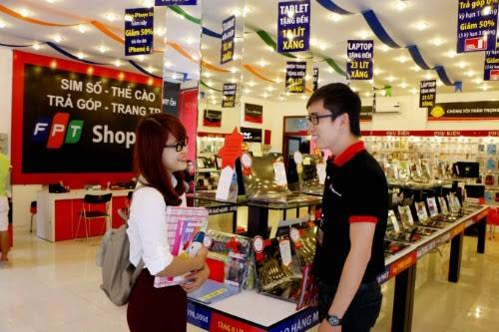
Scenario problem
Notes:
Search online các website
Nếu có thời gian thì đi ra các cửa hàng để tham quan và lấy thông tin từ đó

Slide 6
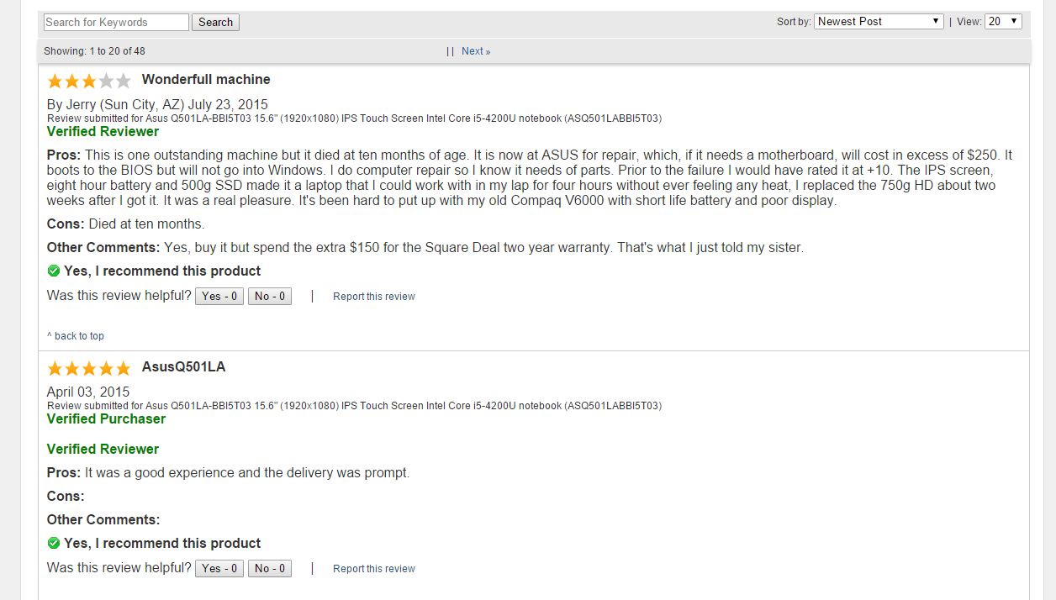
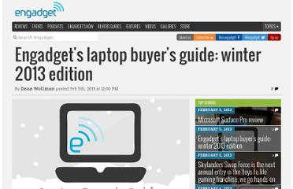
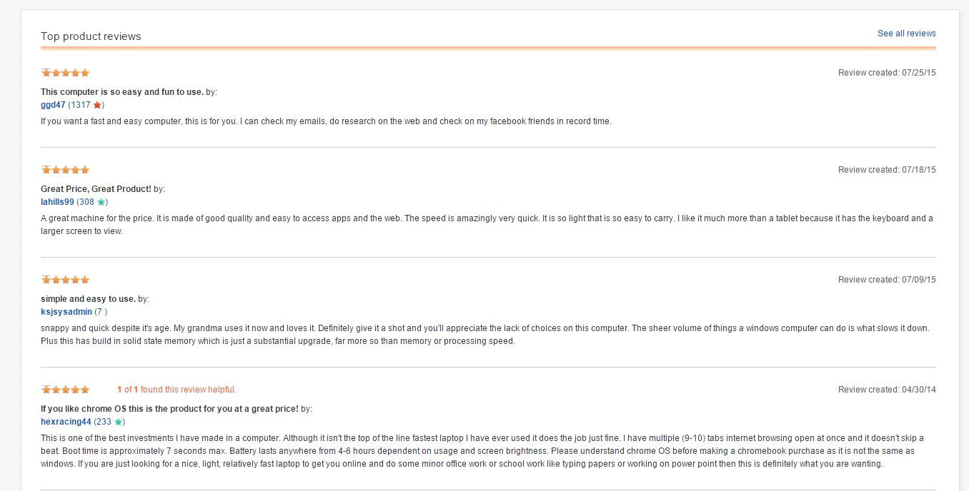
Scenario problem
Take lots of time to search for trusted websites and read all the reviews
1
Notes:
Các website không đáng tin cậy
Thông tin không chính thống, mông lung

Slide 7
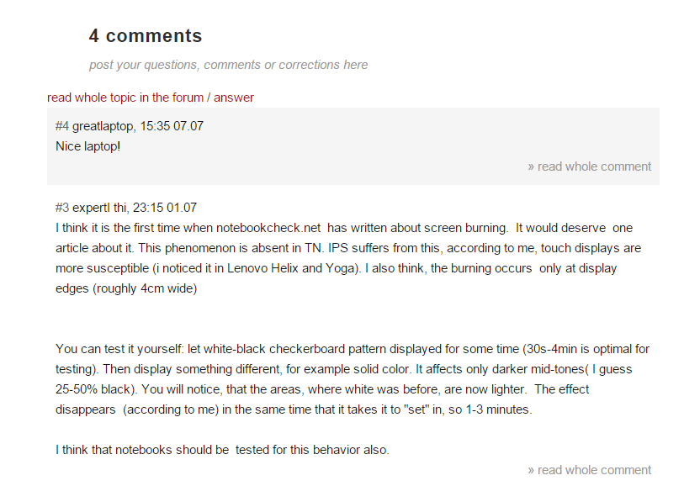

Scenario problem
2
Some reviews may be useless or not relevant.
Notes:
Các bình luận không liên quan
Bình luận không chuẩn, quá ngắn, quá dài và nhiều khi chỉ là một lời cảm thán mang nặng tính cá nhân

Slide 8

Scenario problem
Hard to remember exactly the information these supermarkets provide
3
Notes:
1. Nếu đi ra cửa hàng thì khó nhớ thông tin

Slide 9

Scenario problem
1
2
3
What is the best way to have good reviews?
Notes:
Tìm kiếm thông tin từ những trang web uy tín
Tiến hành làm sạch và chuẩn hóa các bình luận, để người dùng có thể tìm được thông tin nhanh chóng và chính xác

Slide 10
Our Solution

Slide 11


Our solution
Find trusted websites

Slide 12



Our solution
Find trusted websites
Collect information

Slide 13


Our solution
Find trusted websites
Collect information
Standardize comments
Notes:
=> giới thiệu C trình bày cách lấy dữ liệu

Slide 14
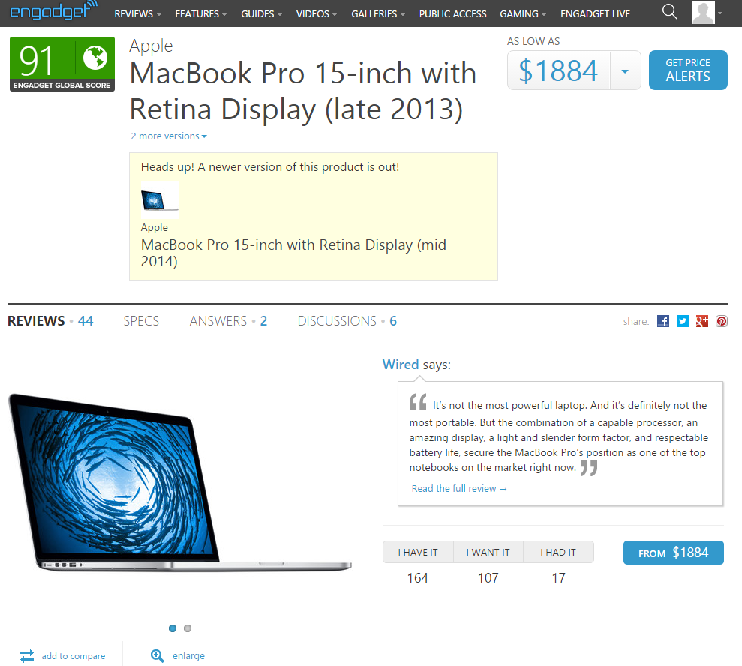
Our solution Step 1: Find trusted website
Notes:
1. de lay thong tin laptop, chung toi phai tim trang web va dua thong tin do ve
chung toi tim dc trang web engadget, day la 1 trang web co thong tin ve laptop kha chuan.

Slide 15




Our idea: Collect data
Notes:
chung toi quyet dinh dung trang web tieng anh boi vi du sao tieng anh cung tot hon tieng viet
ngoai engadget con lay them 2 trang nua, vi nhung trang nay khi cmt thi phai cho staff duyet

Slide 16

Our solution Step 1: Find trusted website
How to get data from this site?
Notes:
va cau hoi dat ra la lam sao de lay dc thong tin tu trang web nay ve

Slide 17
Notes:
Chup trang engadget, cac slide duoi

Slide 18
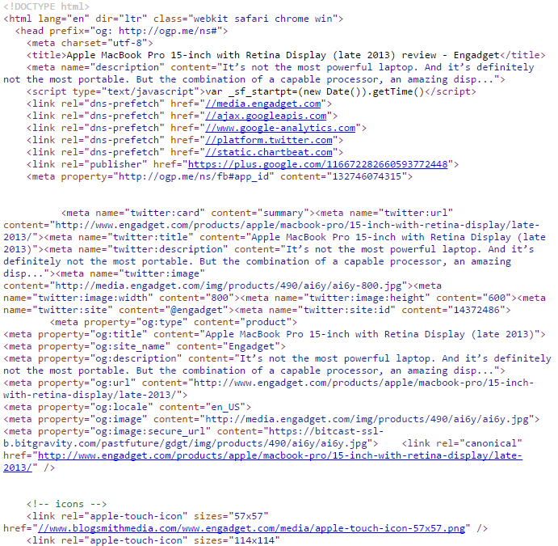
Collect data by parsing
Notes:
show trang engadget len, cho thay trang nay co nhung thong tin: ten, brand, desc, cmt...
chup hinh trang engadget dang html. de parse dc trang html nay thi co solution gi, gap van de gi
Phan tich ra, phong ra tu trang 17. VD ra

Slide 19
Collect data by parsing
xPath
Notes:
show trang engadget len, cho thay trang nay co nhung thong tin: ten, brand, desc, cmt...
chup hinh trang engadget dang html. de parse dc trang html nay thi co solution gi, gap van de gi

Slide 20
Collect data by parsing
Libraries support parsing data:
Selenium
vs
HtmlAgilityPack

Slide 21

Collect data by parsing
Libraries support parsing data:
Selenium
vs
HtmlAgilityPack
Create
simulator browser

Slide 22

Collect data by parsing
Libraries support parsing data:
Selenium
vs
HtmlAgilityPack
Create
simulator browser
Parse data

Slide 23
Collect data by parsing
Libraries support parsing data:
Selenium
vs
HtmlAgilityPack
Create
simulator browser
Parse data
Parse data

Slide 24

Collect data by parsing
Libraries support parsing data:
Selenium
vs
HtmlAgilityPack
Create
simulator browser
Parse data
Decrease speed
Parse data

Slide 25
Collect data by parsing
Libraries support parsing data:
Selenium
vs
HtmlAgilityPack
Create
simulator browser
Parse data
Decrease speed
Parse data

Slide 26

Collect data by parsing

Slide 27

Collect data by parsing
Take url
Remove script

Slide 28

Collect data by parsing
Take url
Download
Remove script

Slide 29

Collect data by parsing
Take url
Download
Remove script
Display

Slide 30

Collect data by parsing
Take url
Download
Remove script
Display
Inspect
Notes:
Inspect ? => s

Slide 31
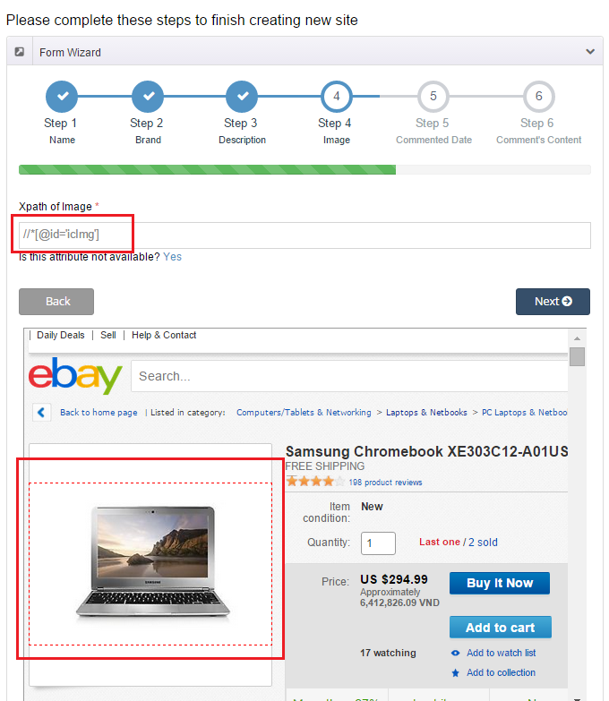
How to get data?

Slide 32
Collect data by parsing
Step 1: From clicked node

Slide 33
Collect data by parsing
Step 1: From clicked node
Step 2: Get parent node

Slide 34
Collect data by parsing
Step 1: From clicked node
Step 2: Get parent node
Step 3: Stop when meeting “HTML” or “ID” node

Slide 35
Collect data by parsing
Step 1: From clicked node
Step 2: Get parent node
Step 3: Stop when meeting “HTML” or “ID” node
Step 4: Take xPath

Slide 36
Collect data by parsing
Step 1: From clicked node
Step 2: Get parent node
Step 3: Stop when meeting “HTML” or “ID” node
Step 4: Take xPath
Step 5: Get data

Slide 37
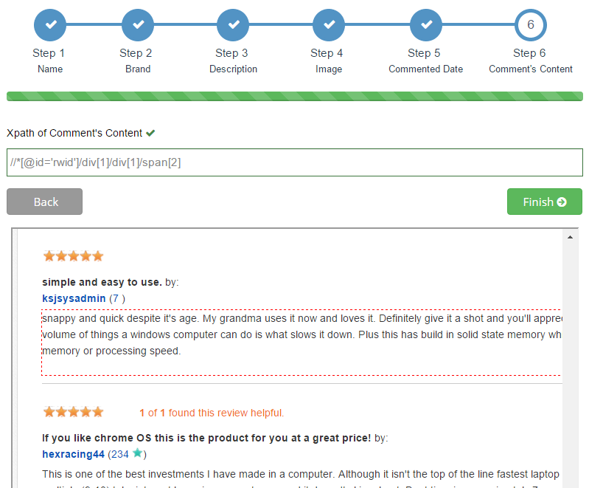
Step 1, 2 & 3: Get parent node, stop when meeting “html” or “id” node

Slide 38
Step 1, 2 & 3: Get parent node, stop when meeting “html” or “id” node
Clicked node
span[2]

Slide 39
Step 1, 2 & 3: Get parent node, stop when meeting “html” or “id” node
Parent node
Clicked node
div[1] /
span[2]

Slide 40
Step 1, 2 & 3: Get parent node, stop when meeting “html” or “id” node
Parent node
Clicked node
div[1] /
div[1] /
span[2]

Slide 41
Step 1, 2 & 3: Get parent node, stop when meeting “html” or “id” node
“id” node
Parent node
Clicked node
*[@id='rwid']/
div[1] /
div[1] /
span[2]

Slide 42
Step 1, 2 & 3: Get parent node, stop when meeting “html” or “id” node
“id” node
Parent node
Clicked node
//
*[@id='rwid']/
div[1] /
div[1] /
span[2]

Slide 43
Step 1, 2 & 3: Get parent node, stop when meeting “html” or “id” node
“id” node
Parent node
Clicked node
//
*[@id='rwid']/
div[1] /
div[1] /
span[2]
//*[@id='rwid']/div[1]/div[1]/span[2]

Slide 44
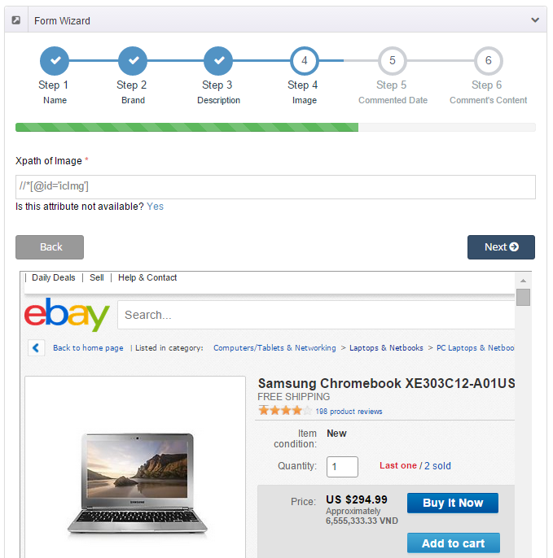
Step 4&5: Take xPath and Get data

Slide 45
Step 4&5: Take xPath and Get data

Slide 46
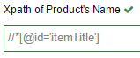
Step 4&5: Take xPath and Get data

Slide 47
Step 4&5: Take xPath and Get data

Slide 48
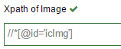
Step 4&5: Take xPath and Get data

Slide 49

Step 4&5: Take xPath and Get data
Samsung Chromebook XE303C12-A01US

Slide 50
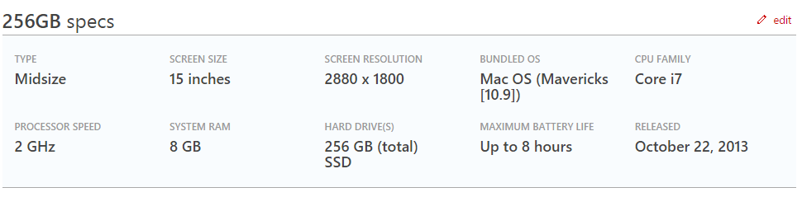
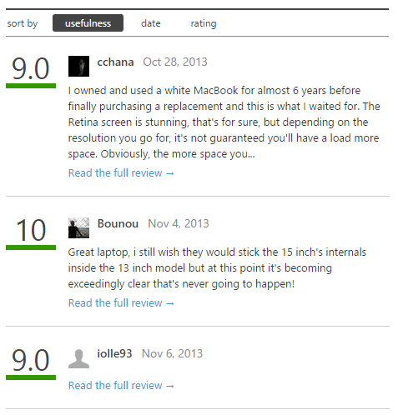
Collect data by parsing
Notes:
show trang engadget len, cho thay trang nay co nhung thong tin: ten, brand, desc, cmt...
chup hinh trang engadget dang html. de parse dc trang html nay thi co solution gi, gap van de gi

Slide 51
Collect data by parsing
We have these entities
Product
Url
Name
Brand
Description
Image
Comment’s date
Comment’s content

Slide 52
Collect data by parsing
We have these entities
Product
Url
Name
Brand
Description
Image
Lats comment’s date
Comment’s content

Slide 53
Collect data by parsing
We have these entities
Product
Site
Url
Name
Brand
Description
Image
Lats comment’s date
Comment’s content
Domain
Name’s xpath
Brand’s xpath
Description’s xpath
Image’s xpath
Date’s xpath
Content’s xpath

Slide 54
Collect data by parsing
We have these entities
Product
Site
Url
Name
Brand
Description
Image
Lats comment’s date
Comment’s content
Domain
Name’s xpath
Brand’s xpath
Description’s xpath
Image’s xpath
Date’s xpath
Content’s xpath
0..*
1..*
Notes:
trong qua trinh collection du lieu, chung toi da nhan thay dc 1 dieu: 2 trang web khac nhau voi cung 1 laptop co thong tin khac nhau. vi vay chung toi moi nghi ra cach
problem

Slide 55
Collect data by parsing
We have these entities
Product
Site
Brand
Description
Image
Domain
Name’s xpath
Brand’s xpath
Description’s xpath
Image’s xpath
Date’s xpath
Content’s xpath
0..*
1..*
Alias Product
Url
Name
Lats comment’s date
Content’s xpath

Slide 56
Detect Duplicated Product String Comparision
Step 1: Split into a list of character pairs

Slide 57
Detect Duplicated Product String Comparision
Step 1: Split into a list of character pairs
Step 2: Count how many adjacent character pairs

Slide 58
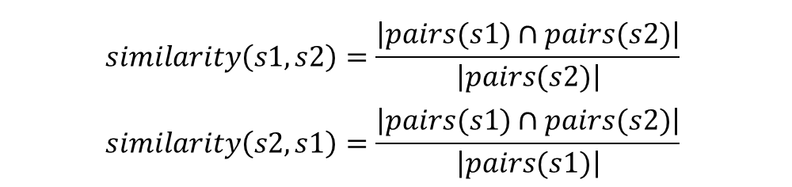
Detect Duplicated Product String Comparision
Step 1: Split into a list of character pairs
Step 2: Count how many adjacent character pairs
Step 3: Calculate matching percent
$$similarity\left(s1,s2\right)=\frac{\left|pairs(s1)∩pairs(s2)\right|}{\left|pairs(s2)\right|}$$
$$similarity\left(s2,s1\right)=\frac{\left|pairs(s1)∩pairs(s2)\right|}{\left|pairs(s1)\right|}$$

Slide 59
Detect Duplicated Product String Comparision
s1
s2
MacBook Air 2015
MacBook Air 2015 Retina

Slide 60
Detect Duplicated Product String Comparision
s1
s2
MacBook Air 2015
MacBook Air 2015 Retina
MACBOOK AIR 2015
MACBOOK AIR 2015 RETINA

Slide 61
Detect Duplicated Product String Comparision
s1
s2
MacBook Air 2015
MacBook Air 2015 Retina
MACBOOK AIR 2015
MACBOOK AIR 2015 RETINA
$$\left\{MA,AC,CB,BO,OO,OK,AI,IR,20,01,15\right\}$$
$$\left\{MA,AC,CB,BO,OO,OK,AI,IR,20,01,15,RE,ET,TI,IN,NA\right\}$$

Slide 62
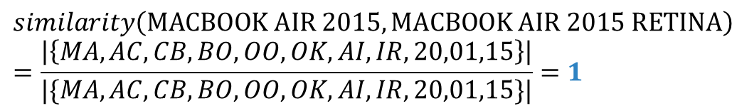
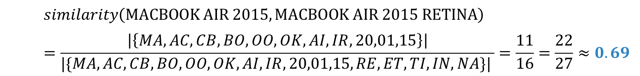
Detect Duplicated Product String Comparision
s1
s2
MacBook Air 2015
MacBook Air 2015 Retina
MACBOOK AIR 2015
MACBOOK AIR 2015 RETINA
$$\left\{MA,AC,CB,BO,OO,OK,AI,IR,20,01,15\right\}$$
$$\left\{MA,AC,CB,BO,OO,OK,AI,IR,20,01,15,RE,ET,TI,IN,NA\right\}$$
$$similarity\left(MACBOOK AIR 2015,MACBOOK AIR 2015 RETINA\right)=\frac{\left|\left\{MA,AC,CB,BO,OO,OK,AI,IR,20,01,15\right\}\right|}{|\{MA,AC,CB,BO,OO,OK,AI,IR,20,01,15,RE,ET,TI,IN,NA\}| }=\frac{11}{16}=\frac{22}{27}≈0.69$$
$$similarity\left(MACBOOK AIR 2015,MACBOOK AIR 2015 RETINA\right)=\frac{\left|\left\{MA,AC,CB,BO,OO,OK,AI,IR,20,01,15\right\}\right|}{|\{MA,AC,CB,BO,OO,OK,AI,IR,20,01,15\}|}=1$$
Notes:
Them ct min

Slide 63
Detect Duplicated Product String Comparision
<
similarity(s1, s2) = 69 %
similarity(s2, s1) = 100 %
similarity = 69 %

Slide 64

Detect Duplicated Product
New laptop

Slide 65

Detect Duplicated Product
New laptop
Data object
Database

Slide 66
Detect Duplicated Product
New laptop
Data object
Database

Slide 67
Detect Duplicated Product
New laptop
Data object
Database
is new
Notes:
Cùng brand và > 40%

Slide 68

Detect Duplicated Product
New laptop
Data object
Database
is new
true
Notes:
dk

Slide 69
Detect Duplicated Product
New laptop
Data object
Database
is new
false
true

Slide 70

Detect Duplicated Product
New laptop
Data object
Database
is new
false
true
save
Notes:
Giới thiệu T trình bày cách xử lý sp trùng

Slide 71







Handle Duplicated Product
Main
Alias
Database
Description
Description
Save
Comments
Comments
Images
Images
Merge
Main

Slide 72


Handle Duplicated Product
MacBook Pro 12' 2015

Slide 73



Handle Duplicated Product
Database
MacBook Pro 12' 2015
MacBook (early 2015)

Slide 74
Handle Duplicated Product
Database
MacBook Pro 12' 2015
MacBook (early 2015)

Slide 75
Handle Duplicated Product
Database
MacBook Pro 12' 2015
MacBook (early 2015)

Slide 76
Handle Duplicated Product
Database
MacBook Pro 12' 2015
MacBook (early 2015)

Slide 77

Handle Duplicated Product
Alias 1
Alias 2
Database
Description
Description
Save
Save
Comments
Comments
Images
Images
Split
New Laptop
New Laptop

Slide 78


Analyzing Comment
In real life
How can system classify the comments?
Can we train it?

Slide 79

Analyzing Comment
Notes:
Ask English teacher

Slide 80

Analyzing Comment
WORDS
4.Other
1.Adjective/
Adverb
3.Noun
2.Verb
Meaning
Pros
Neutral
Cons
Negative

Slide 81


Analyzing Comment – Get words for database
Word Name (Character of word)
Read
WORDS
Word Classes
(Adjective, Adverb,
Verb, Noun, Other)
Staff
Word Types
(Totally Pros, Pros, Cons,
Neutral, Negative)

Slide 82

Analyzing Comment – Get words for database
Word Name
Word Types
Totally Pros, Pros, Cons, Neutral, Negative
Database
Word Classes
Adjective, Adverb, Verb, Noun, Other

Slide 83




Analyzing Comment – Get words for database
+
+
=
Database
System
Better Database

Slide 84

Analyzing Comment
Read
Staff
Classify
System
WORDS
Better Database
Database

Slide 85



Analyzing Comment
Classified
Comment
Negative
Negative
Flag
Collect and Split
into words
System
Totally Pros
WORDS
Compare
Database

Slide 86

Analyzing Comment - Example
Although the speed is slow, I still love this laptop
System
“although” ,”the” , “speed”, ‘is”, “slow”, “I”, “still”, “love”, “this”, “laptop”
Split into words
Compare
Totally Pros
“love”
“slow”,
“love”
Database
Positive Comment

Slide 87

Analyzing Comment – Check Adjectives/Adverbs
Good Flag
Neutral
Flag
Classified
Comment
Negative
Bad Flag
Negative
Flag
Collect and Split
into words
System
Adjective/Adverb
Pros/Cons
Neutral
WORDS
Compare
Database

Slide 88
Analyzing Comment – Check Verbs
Good Flag
Neutral
Flag
Classified
Comment
Negative
Bad Flag
Negative
Flag
Collect and Split
into words
System
Verb
Pros/Cons
Neutral
WORDS
Compare
Database

Slide 89
Analyzing Comment – Check Nouns
Good Flag
Neutral
Flag
Classified
Comment
Negative
Bad Flag
Negative
Flag
Collect and Split
into words
System
Noun
Pros/Cons
Neutral
WORDS
Compare
Database

Slide 90
Analyzing Comment - After checking all word’s classes
Neutral
Flag
Neutral Comment

Slide 91
Analyzing Comment - Example
Despite slow speed, the screen is beautiful and the keyboard is good
System
“despite”, “slow”, “speed”, “the”, “screen”, “is”, “beautiful”, “and”, “the”, “keyboard”, “is”, “good”
Split into words
Pros
Compare
Good Flag
Adjective/Adverb
“good”
“slow”,
“beautiful”,
“good”
+
“beautiful”
Pros
Database
Good Flag
Adjective/Adverb
“slow”
<
Positive
comment
Cons
Bad Flag
Adjective/Adverb

Slide 92

Analyzing Comment - Summary
Classified
Words
Read and classify
words
Staff
System
Database
Classified
comments
Compare with
classified words
System
WORDS
Collect and Split
into words
Raw Comments

Slide 93


Our solution - Summary
Collect
Classify
System
Laptops with comments
Comments

Slide 94
Features
Search
Report comment
Recommend product
Classify comment
Import Excel
Get data from web
Mobile application

Slide 95
Demonstration
Scenario 1: Search laptop and report comment
Guest

Slide 96

Demonstration
Scenario 1: Search laptop and report comment
Search
Guest

Slide 97
Demonstration
Scenario 1: Search laptop and report comment
Search
Read comments
Guest

Slide 98


Demonstration
Scenario 1: Search laptop and report comment
Search
Read comments
Guest
Report

Slide 99

Demonstration
Scenario 1: Search laptop and report comment
Search
Read comments
Guest
Report
Handle
Staff

Slide 100



Search and parse recommended product automatically

Slide 101
Search and parse recommended product automatically
order by report times

Slide 102
Search and parse recommended product automatically
order by report times

Slide 103

Search and parse recommended product automatically

Slide 104



Search and parse recommended product automatically

Slide 105

Search and parse recommended product automatically
Url of
recommended product
Search

Slide 106
Search and parse recommended product automatically
Url of
recommended product
Search
Parse data

Slide 107

Search and parse recommended product automatically
Url of
recommended product
Search
Parse data
Send email

Slide 108
Demonstration
Scenario 2: Search laptop and recommend laptop
Guest

Slide 109
Demonstration
Scenario 2: Search laptop and recommend laptop
Search
Guest

Slide 110

Demonstration
Scenario 2: Search laptop and recommend laptop
Search
(no result)
Guest

Slide 111

Demonstration
Scenario 2: Search laptop and recommend laptop
Search
(no result)
Guest
Recommend

Slide 112
Demonstration
Scenario 2: Search laptop and recommend laptop
Search
(no result)
Guest
Recommend
Handle
System
Notes:
Chuyen wa email, demo

Slide 113
Demonstration
Scenario 2: Search laptop and recommend laptop
Search
(no result)
Guest
Recommend
Handle
Handle
Handle
Staff
System
Notes:
Gioi thieu T demo train machine.

Slide 114
Demonstration
Scenario 3: Parse data and handle duplicated products
Parse
System

Slide 115
Demonstration
Scenario 3: Parse data and handle duplicated products
Parse
Handle
Staff
System
Notes:
Gioi thieu anh K trinh bay mobile

Slide 116

Mobile Application
Guest

Slide 117

Mobile Application
Guest

Slide 118

Mobile Application
Request
Guest

Slide 119
Mobile Application
Request
Respond
Guest

Slide 120
Mobile Application
Features
Search
Report comment
Recommend product
Write comment
Add favorite product

Slide 121
Demonstration
Scenario 4: Search laptop and write comment
Search
Guest

Slide 122
Demonstration
Scenario 4: Search laptop and write comment
Search
Guest
Read comments

Slide 123

Demonstration
Scenario 4: Search laptop and write comment
Search
Guest
Read comments
Add favorite

Slide 124

Demonstration
Scenario 4: Search laptop and write comment
Search
Guest
Read comments
Add favorite
Write

Slide 125
Demonstration
Scenario 1<Mobile>: Search laptop and report comment
Search
Read comments
Guest
Report

Slide 126
Demonstration
Scenario 2<Mobile>: Search laptop and recommend laptop
Search
(no result)
Guest
Recommend
Handle
Handle
Staff
System

Slide 127
Features that haven’t shown?
Import excel file
Import dictionary file
Manage product
Manage dictionary
Manage account
Manage profile

Slide 128
Advantages AND Disadvantages
Advantages:
Collect data from trusted resources
Provide classified comments
Training machine (work with duplicate products).
Guest can contribute to standardize comments
Guest can suggest new laptops

Slide 129
Advantages AND Disadvantages
Disadvantages:
Lack of source websites
Analyzing algorithm is not optimized. Some comments cannot be classified correctly.
Haven’t had auto-update dictionary function.
Mobile application is developed for Android Platform.

Slide 130
Future plans
Enrich words in database to have better analyzing.
Build automatic mechanism to update words in database
Use for other fields such as mobile reviews or any business fields that need to collect user reviews/behaviors and classify them for some business purposes.
Support more mobile platforms such as Windows Phone or iOS.
Notes:
1. Mở rộng database, tăng số vốn từ

Slide 131


Slide 132
Thank You!

